Slide 1
Automatic Road Extraction from Satellite Image
Group 10
Ishan Arora (IIT2017501)
Vikrant Singh (IIT2017502)
Srikar Anand (IIT2017504)
Akshay Gupta (IIT2017505)
Naman Deept (IIT2017507)

Slide 2
Abstract
This paper presents the project titled ”Automatic Road Extraction from Satellite Image” which aims to extract Road networks from Satellite images of the ground. This is more challenging compare to roadextraction from the aerial images because satellite images are more noisy and comparatively of the lower resolution than the aerial images. Variety of the network structures with different number of the epochs or iteration times are used to train the model and to determine the model with best network structure so that results can be obtained with more accuracy.

Slide 3
Introduction
Road network detection is the process of detecting and extracting the road network from high resolution satellite images. It is essential for many applications like map generation and updating. To do this road network detection, resolution of satellite images plays an important role. If experts try to label the road pixels manually, it will take more time and will lead to errors. Hence an automatic method is proposed here.
Satellite images consist of the various parts of the earth and various other planet and stars which are taken through the use of the satellites. Satellite images provides the details about various natural and man-made features of the earth. These help in the various fields of studies like astronomy, agriculture, geology, etc. These are also used in google maps which help in finding and locating the different paths and locations. Road extraction from these images is one of the most important application as it can be of great help for the map, tourists,cabs, etc

Slide 4
Literature Review : Road detection from Satellite Images, Inter-national Journal of Applied Earth Observa-tion and Geoinformation (2007)
Deals with the possiblity of using Artificial Neural Networks for detecting Roads from High-Resolution Satellite Images on a part of RGB Ikonos and Quick-Bird images from Kish Island and Bushehr Harbor. One of the most important advantages of neural networks as compared to conventional statistical methods is that they are distribution-free operators, because the learning and recalling depend on the linear combination of data pattern instead of the statistical parameters of the input data. The output is the pixels of output image,each being 0 (Background Pixel) or 1 (Road pixel). It was found that there is no need to design more than 10 neurodes in hidden layer as it does not improve results noticeably

Slide 5
Literature Review : Road Extraction from High Resolution Image with Deep Convolution Network
This paper which was named as ”Road Extraction from High Resolution Image with Deep Convolution Network” was published in March 2018 by National Engineering Laboratory for Transportation Safety and Emergency Informatics, and authored by Wei Xia, Yu-Ze Zhang,Jian Liu, Lun Luo and Ke Yang. In this paper the authors tried to make a Deep Convolutional Neural Network (DCNN) which would detect Roads in Satellite Images taken by the Satellite GF-2. TheGF-2 satellite data is used for experiments, as its images may show optical distortion in small pieces. Experiments in this paper showed an accuracy of more than 80%

Slide 6
Literaure Review : Automated Road Extraction from High Res-olution Satellite Images
This paper was produced in International Conference on Emerging Trends in Engineering, Science and Technology (ICETEST - 2015)authored by Jose Hormese and Dr. C. Saravanan . In this paper they illustrated a novel approach to road extraction from satellite images using vectorisation approach which mainly applied through 3 steps.
1. the image is segmented to roughly identify the road network regions
2. the decision making and continuity procedure to correctly detect the roads
3. the Vectorization step to identify the line segments or curveds egments which represent the roads segmentation .

Slide 7
Proposed Methodology
In this paper we shall be using a Deep Convolutional Neural Network (DCNN)
DCNN provide a satisfactory result for iden-tifying the road from satellite images
There are two approaches that can be implemented with this ANN :
Binary Classification
Regression
Binary Classification approach, in which each output pixel in labelled as 0 (Background pixel) or as 1 (Road pixel) according to the corresponding input pixel. In this binary segmentation the spatial tolerance is zero
The second approach however has non-zero spatial tolerance that is adjustable. This is a regression based approach. In this, each output pixel has a value between 0 and 1 that represents how close or how probable that the pixel is a road pixel
The idea is to give a even target distribution that is centered along the road labels, having a maximum value of one that is assigned to the road labels which uniformly decreases to zero for the background other than the roads

Slide 8
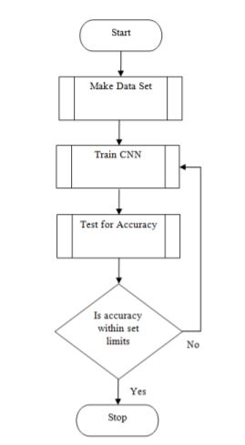
Models and Methods
CNN based models would be the best choice for such a problem since CNN based model provide excellent results with problem involving image classification and segmentation

Slide 9
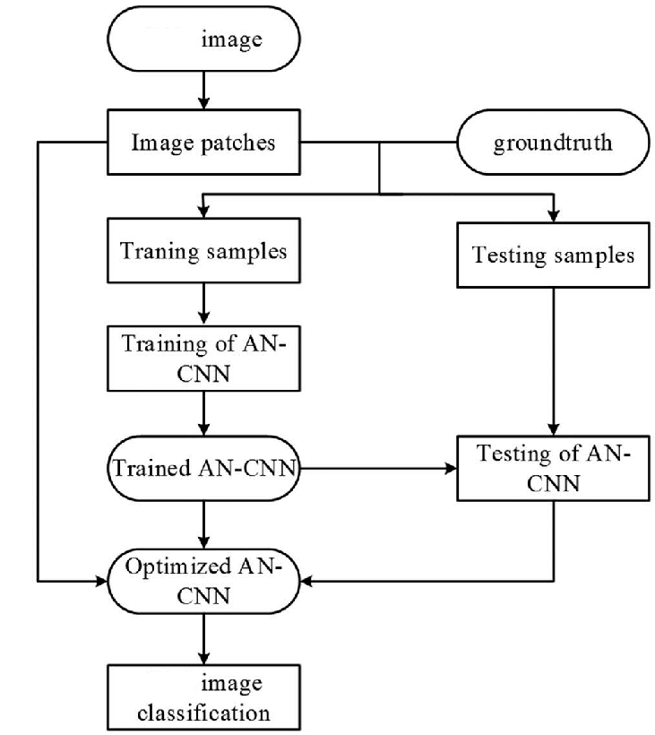
Figure : CNN based model solution for the given problem for road extraction from satellite images

Slide 10
Dataset:
We will use the dataset available from the following two sources:
•Satellite Road Segmentation by Wurenzhe:
https://www.kaggle.com/wurenzhe/satellite-road-segmentation
•EPFL ML Road Segmentation:
https://www.kaggle.com/c/epfml-segmentation/data

Slide 11
Base Paper:
The base paper to be used by us for the implementation will be "Road detection from high-resolution satellite images using artificial neural networks" by M. Mokhtarzade and M.J. Valadan Zoej.
The reference for the same is given in [1].

Slide 12
Project Timeline
Mid feb
March Mid
March End
First Week of April
Mid of April
End of April
Project Title Finalised
Methodology Finalisation And Dataset Collection
Testing
User Acceptance
Final Evaluation
Coding and Implementation

Slide 13
ACTIVITY TIME CHART
Project Title - Start of February
Literature Review, Problem Statement, Formulation and Report - Mid-February
Finalizing Methodology - End of February
Understanding and learning concepts and technologies required - First Week of March
Dataset Collection - First Week of March
Coding and Implementation - March End to April
Testing and Improvement - End of April

Slide 14
Language , Tools and Requirements
Python 2,3
Keras , Tensorflow , OpenCV and PyTorch Libraries
Operating System - Linux (Ubuntu) or Windows
Intel i5 or above processor
RAM - 8GB minimum

Slide 15
Conclusion
The Deep Convolution Neural Network proposed here contains multiple feature for road classification that can be done either through supervised learning or the unsupervised learning based on the kind of available data-sets . Through various research methodologies that has been studied , the Convolutional Neural Network is found to be the best in context for the image recognition system .
The results shown in the base paper can be further improved using image enhancement techniques (like histogram equalization) ,So basically we are adding an extra layer to our base paper which will lead to more precise output (fine tuning and image enhancement).
The main concept can also be extended to adjusting the values of hyper-parameters like learning rates ,kappa coefficient values and the error coefficient in our basic training of convolutional neural networks .

Slide 16
References:
[1] M. Mokhtarzade and M.J. Valadan Zoej, ”Road detection from high-resolution satel-lite images using artificial neural networks”, International Journal of Applied EarthObservation and Geoinformation, 2007 32-40.
[2] Wei Xia, Yu-Ze Zhang, Jian Liu, Lun Luo and Ke Yang,”Road Extraction from HighResolution Image with Deep Convolution Network—A Case Study of GF-2 Image”,22-March-2018, National Engineering Laboratory for Transportation Safety andEmergency Informatics, China Transport Telecommunications Information Center,Beijing.
[3] Jose Hormese , Dr. C Saravanan, ”Automated Road Extraction From High Reso-lution Satellite Images”, National Institute of Durgapur , International Conferenceon Emerging Trends in Engineering, Science and Technology (ICETEST - 2015).
[4] Jose Hormese , Chandran Saravanan ,”A CONVOLUTIONAL NEURAL NET-WORK APPROACH TO ROAD CLASSIFICATION FROM SATELLITE IMAGES”, Journal of Theoretical and Applied Information Technology ,15th December 2018.Vol.96. No 23.

Slide 17
References Continued..
[5] P. Yadav and S. Agrawal, ”ROAD NETWORK IDENTIFICATION AND EXTRACTION IN SATELLITE IMAGERY USING OTSU’S METHOD AND CONNECTED COMPONENT ANALYSIS”, GIS Cell, Motilal Nehru National Institute of Technology Allahabad,The International Archives of the Photogrammetry, Remote Sensing and Spatial Information Sciences, Volume XLII-5, 2018 ISPRS TC V Mid-term Symposium “Geospatial Technology –Pixel to People”, 20–23 November 2018, Dehradun, India
[6] Corentin Henry, Seyed Majid Azimi and Nina Merkle, ”Road Segmentation in SAR Satellite Images With Deep Fully Convolutional Neural Networks”,IEEE GEOSCIENCE AND REMOTE SENSING LETTERS, VOL. 15, NO.12, DECEMBER 2018

